Slide 1
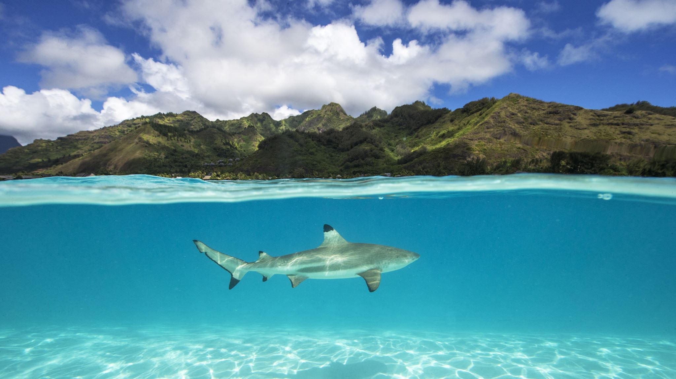
Shark attacks in South Africa

Slide 2
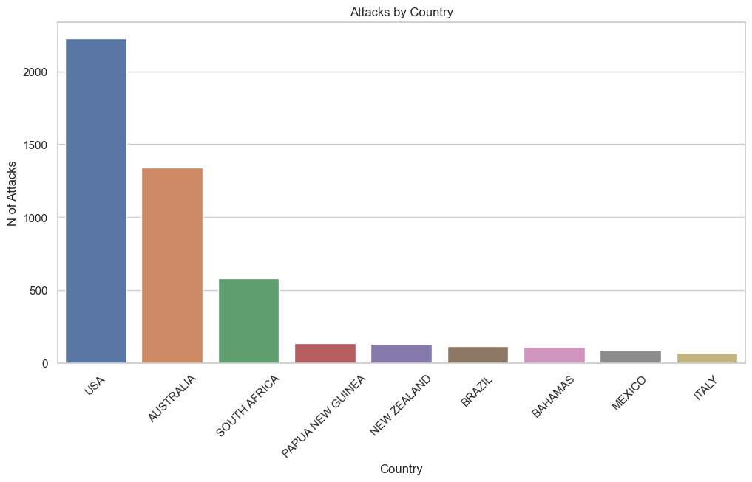
South Africa vs the World
USA → 2.229 reported attacks
AUSTRALIA → 1.338 reported attacks
SOUTH AFRICA → 579 reported attacks

Slide 3
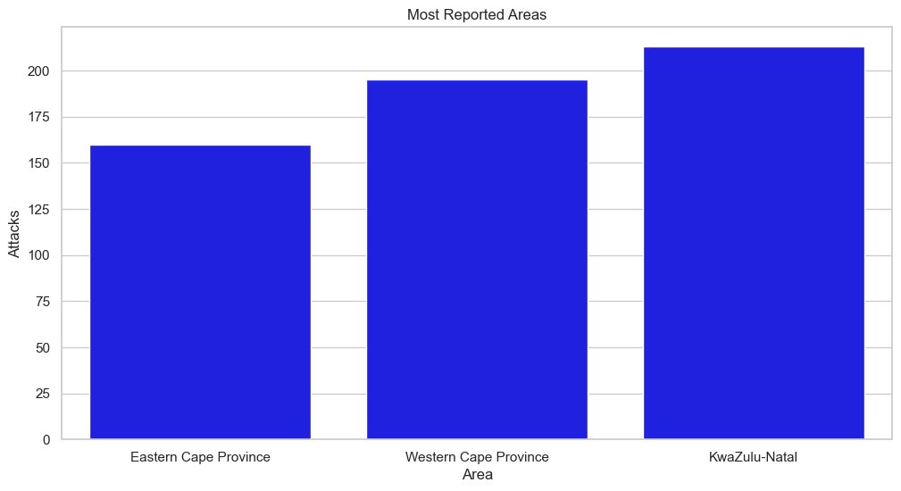
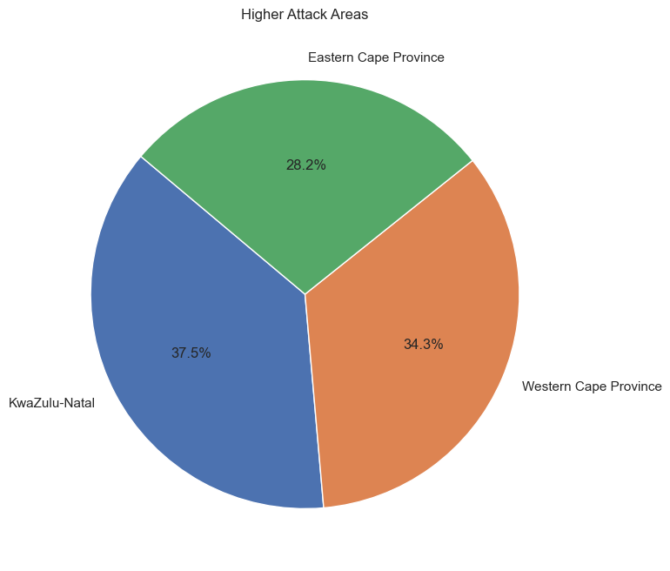
South Africa Areas
KwaZulu-Natal:
37,5 % of the attacks
213 attacks registered
Western Cape:
34,3 % of the attacks
195 attacks registered
Eastern Cape:
28,2 % of the attacks
160 attacks registered

Slide 4
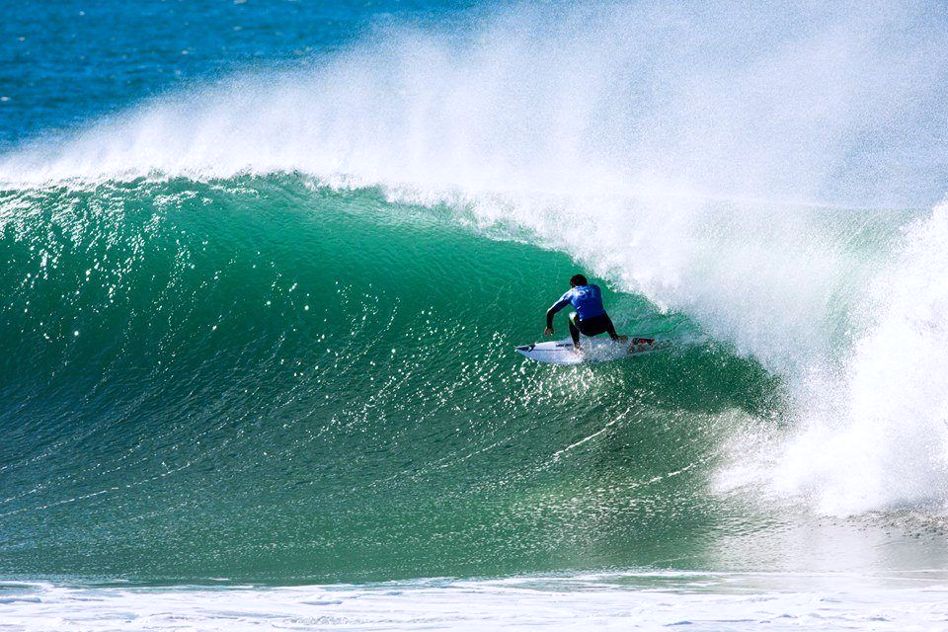
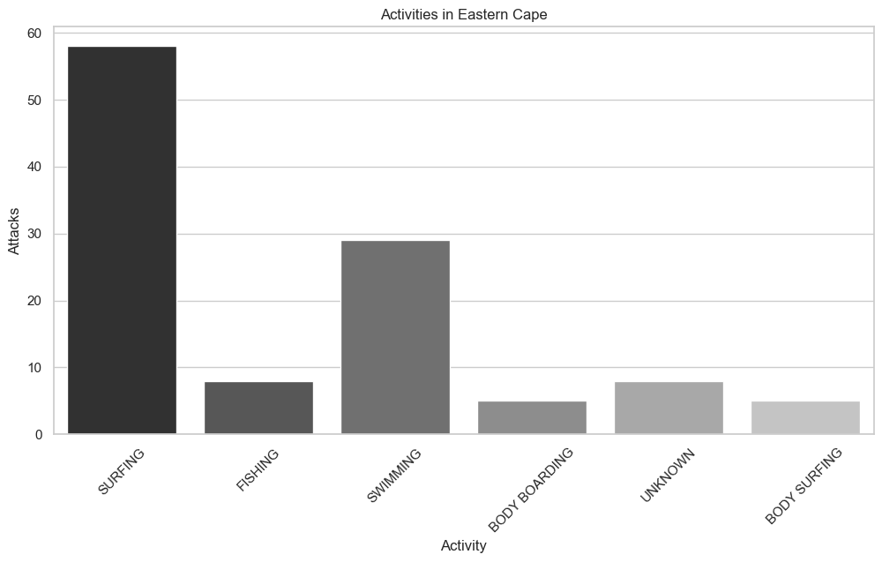
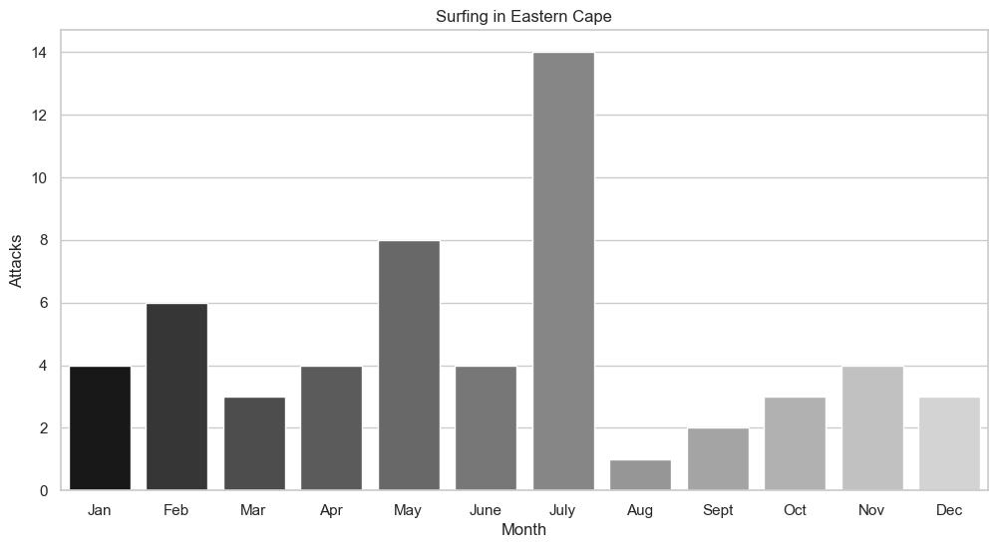
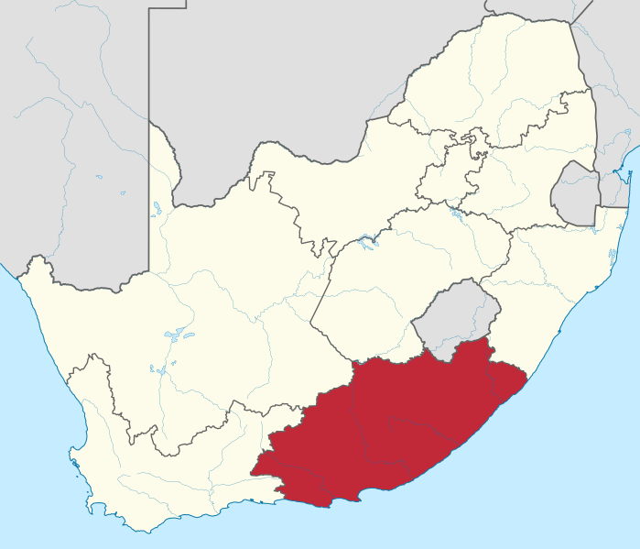
Eastern Cape
Activities
Surfing → 58 registered attacks
Swimming → 29 registered attacks
Surfing
Winter season
July → 14 attacks
June → 8 attacks

Slide 5
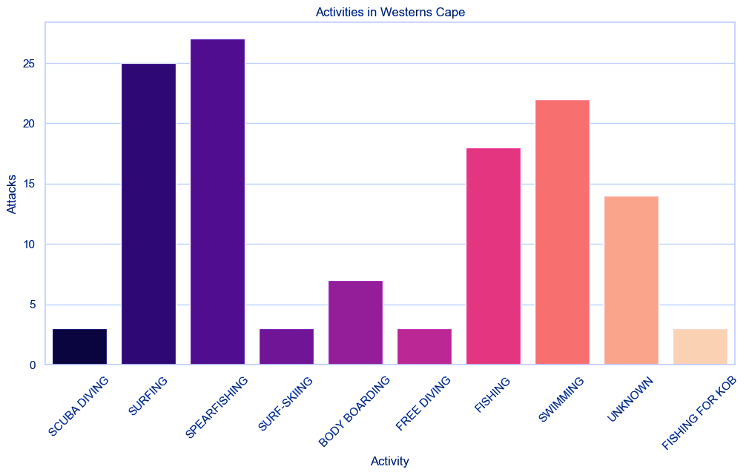
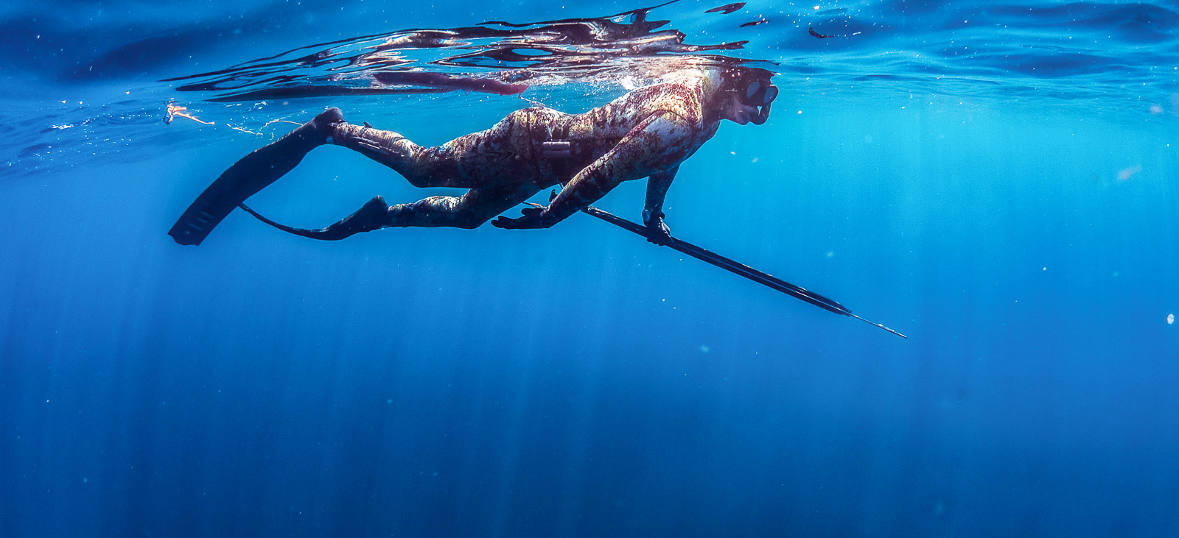
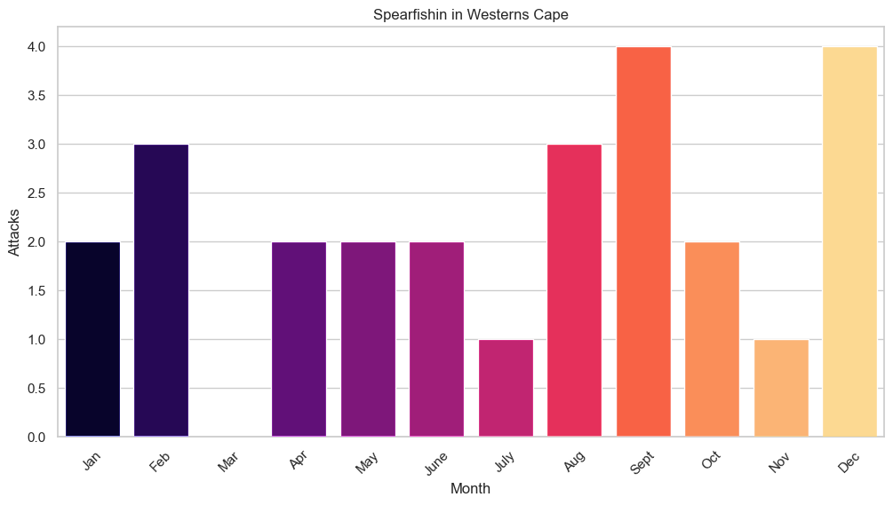
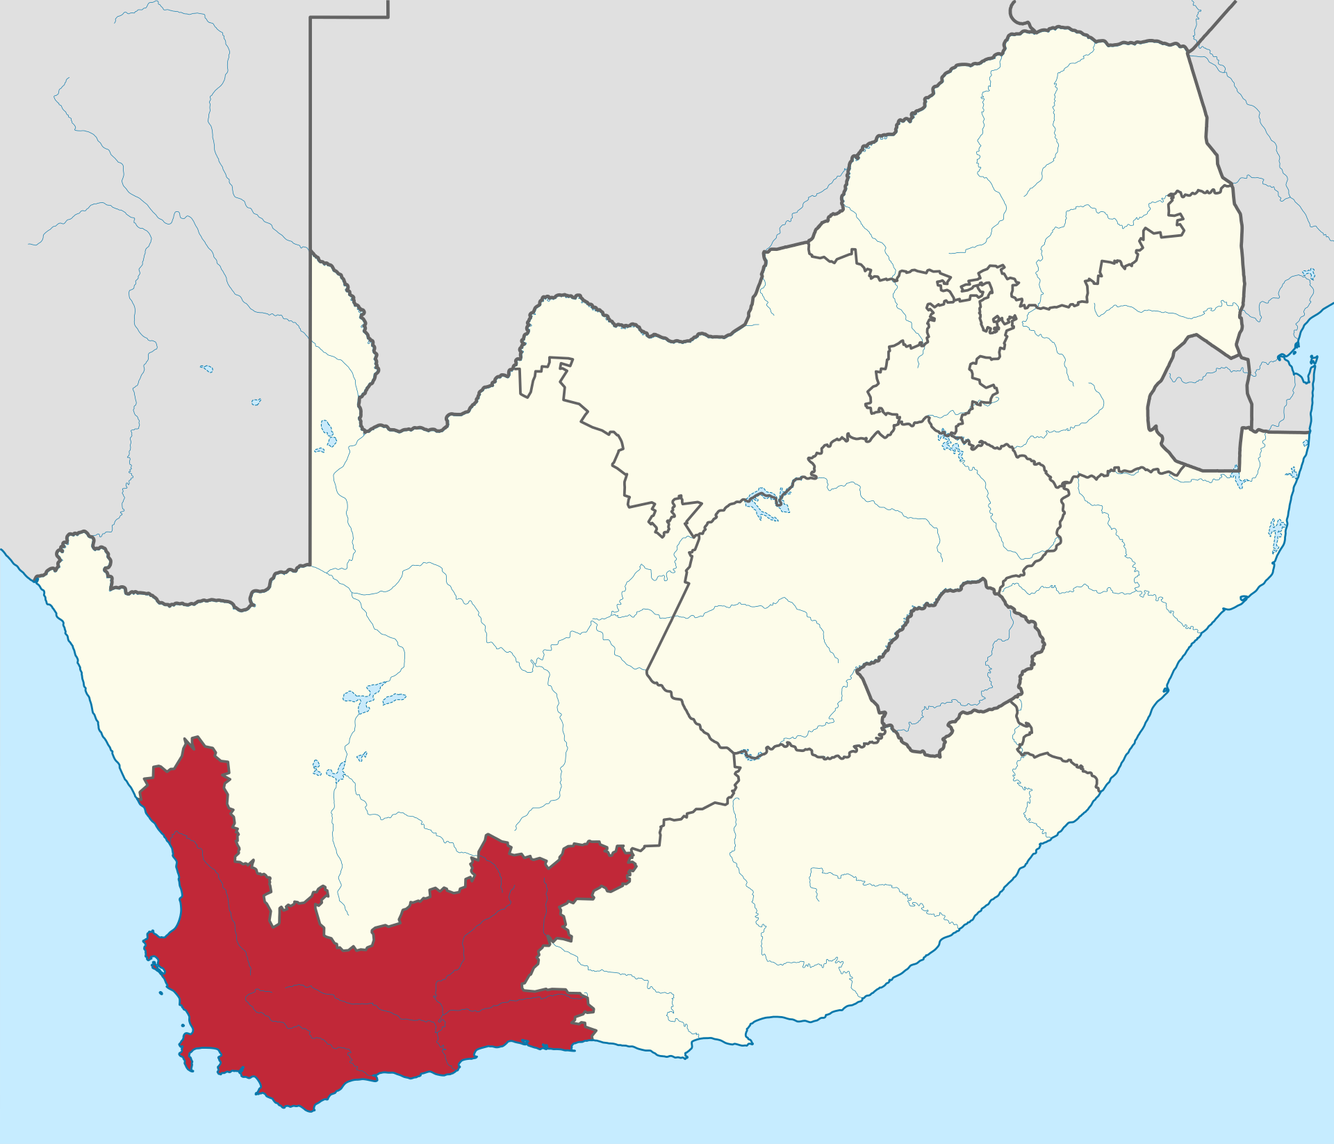
Western Cape
Activities
Spearfishing → 27 registered attacks
Surfing → 25 registered attacks
Swimming → 22 registered attacks
Spearfishing
September and December with 4 attacks reported each.

Slide 6
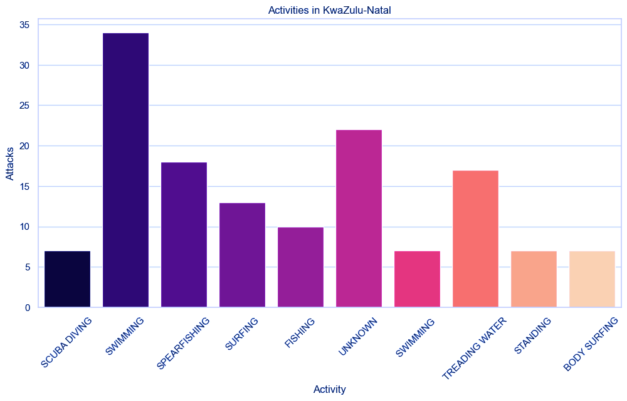

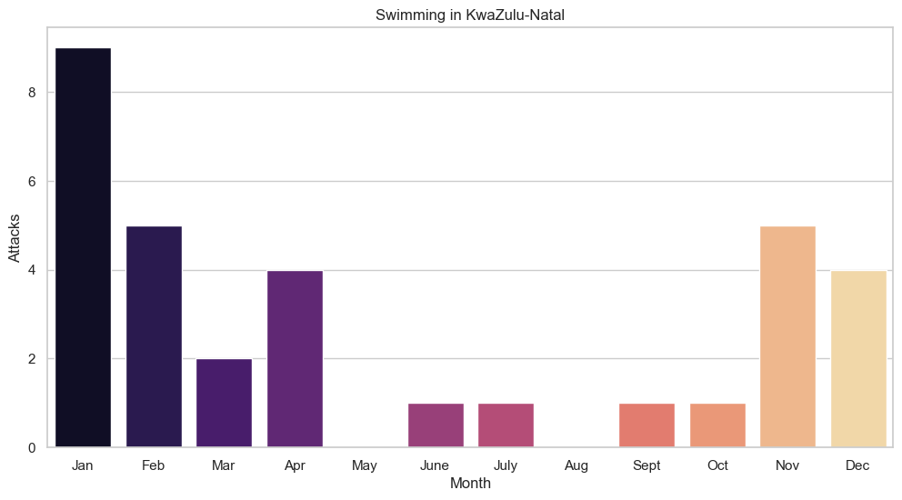
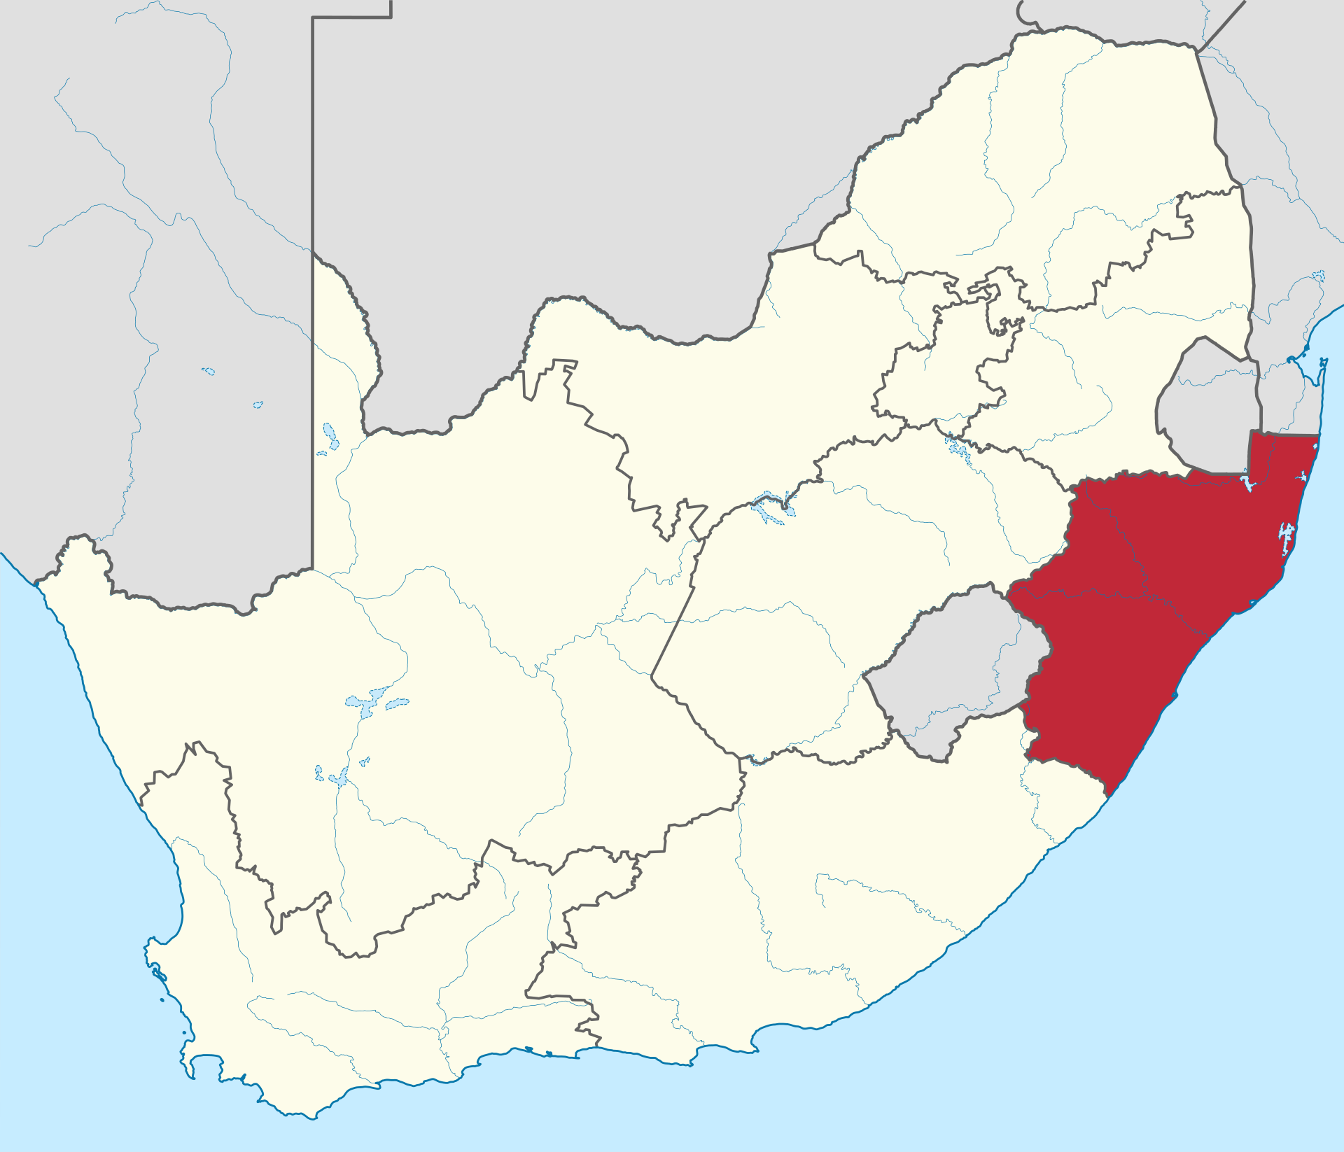
KwaZulu-Natal
Activities
Swimming → 34 attacks reported, Spearfishing → 18 attacks reported
Swimming
Attacks gather in the South African summer season (Nov-Feb)
Jan → 9 attacks

Slide 7





Third country with
more reported shark attacks
Most reports on summer
months
Eastern Cape
Surfing during Winter
Western Cape
Spearfishing during the whole year
Kwazulu-Natal
Swimming during summer

